Slide 1

Games in the Cloud
Juan Davalos Mayur Rahangdale
Purva Choudhary Narbeh Movsesian

Slide 2
Table of Contents
History of Games
Gaming on the Cloud
Use Case 1: Cloud Gaming in Education
Use Case 2: Google Stadia
Reference Architecture of a Cloud Game-streaming Service
Other Key Issues

Slide 3
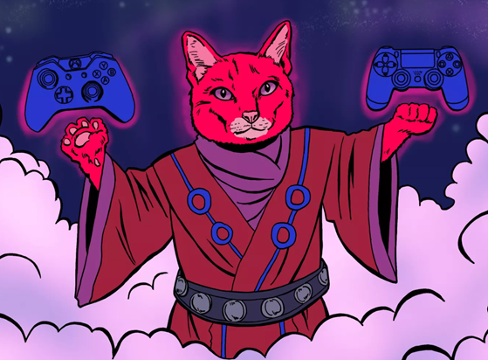
How does Cloud Gaming Work?
Gaming on the go
Drastically better performance
No need for investing in high grade equipment
Fraction of original costs

Slide 4
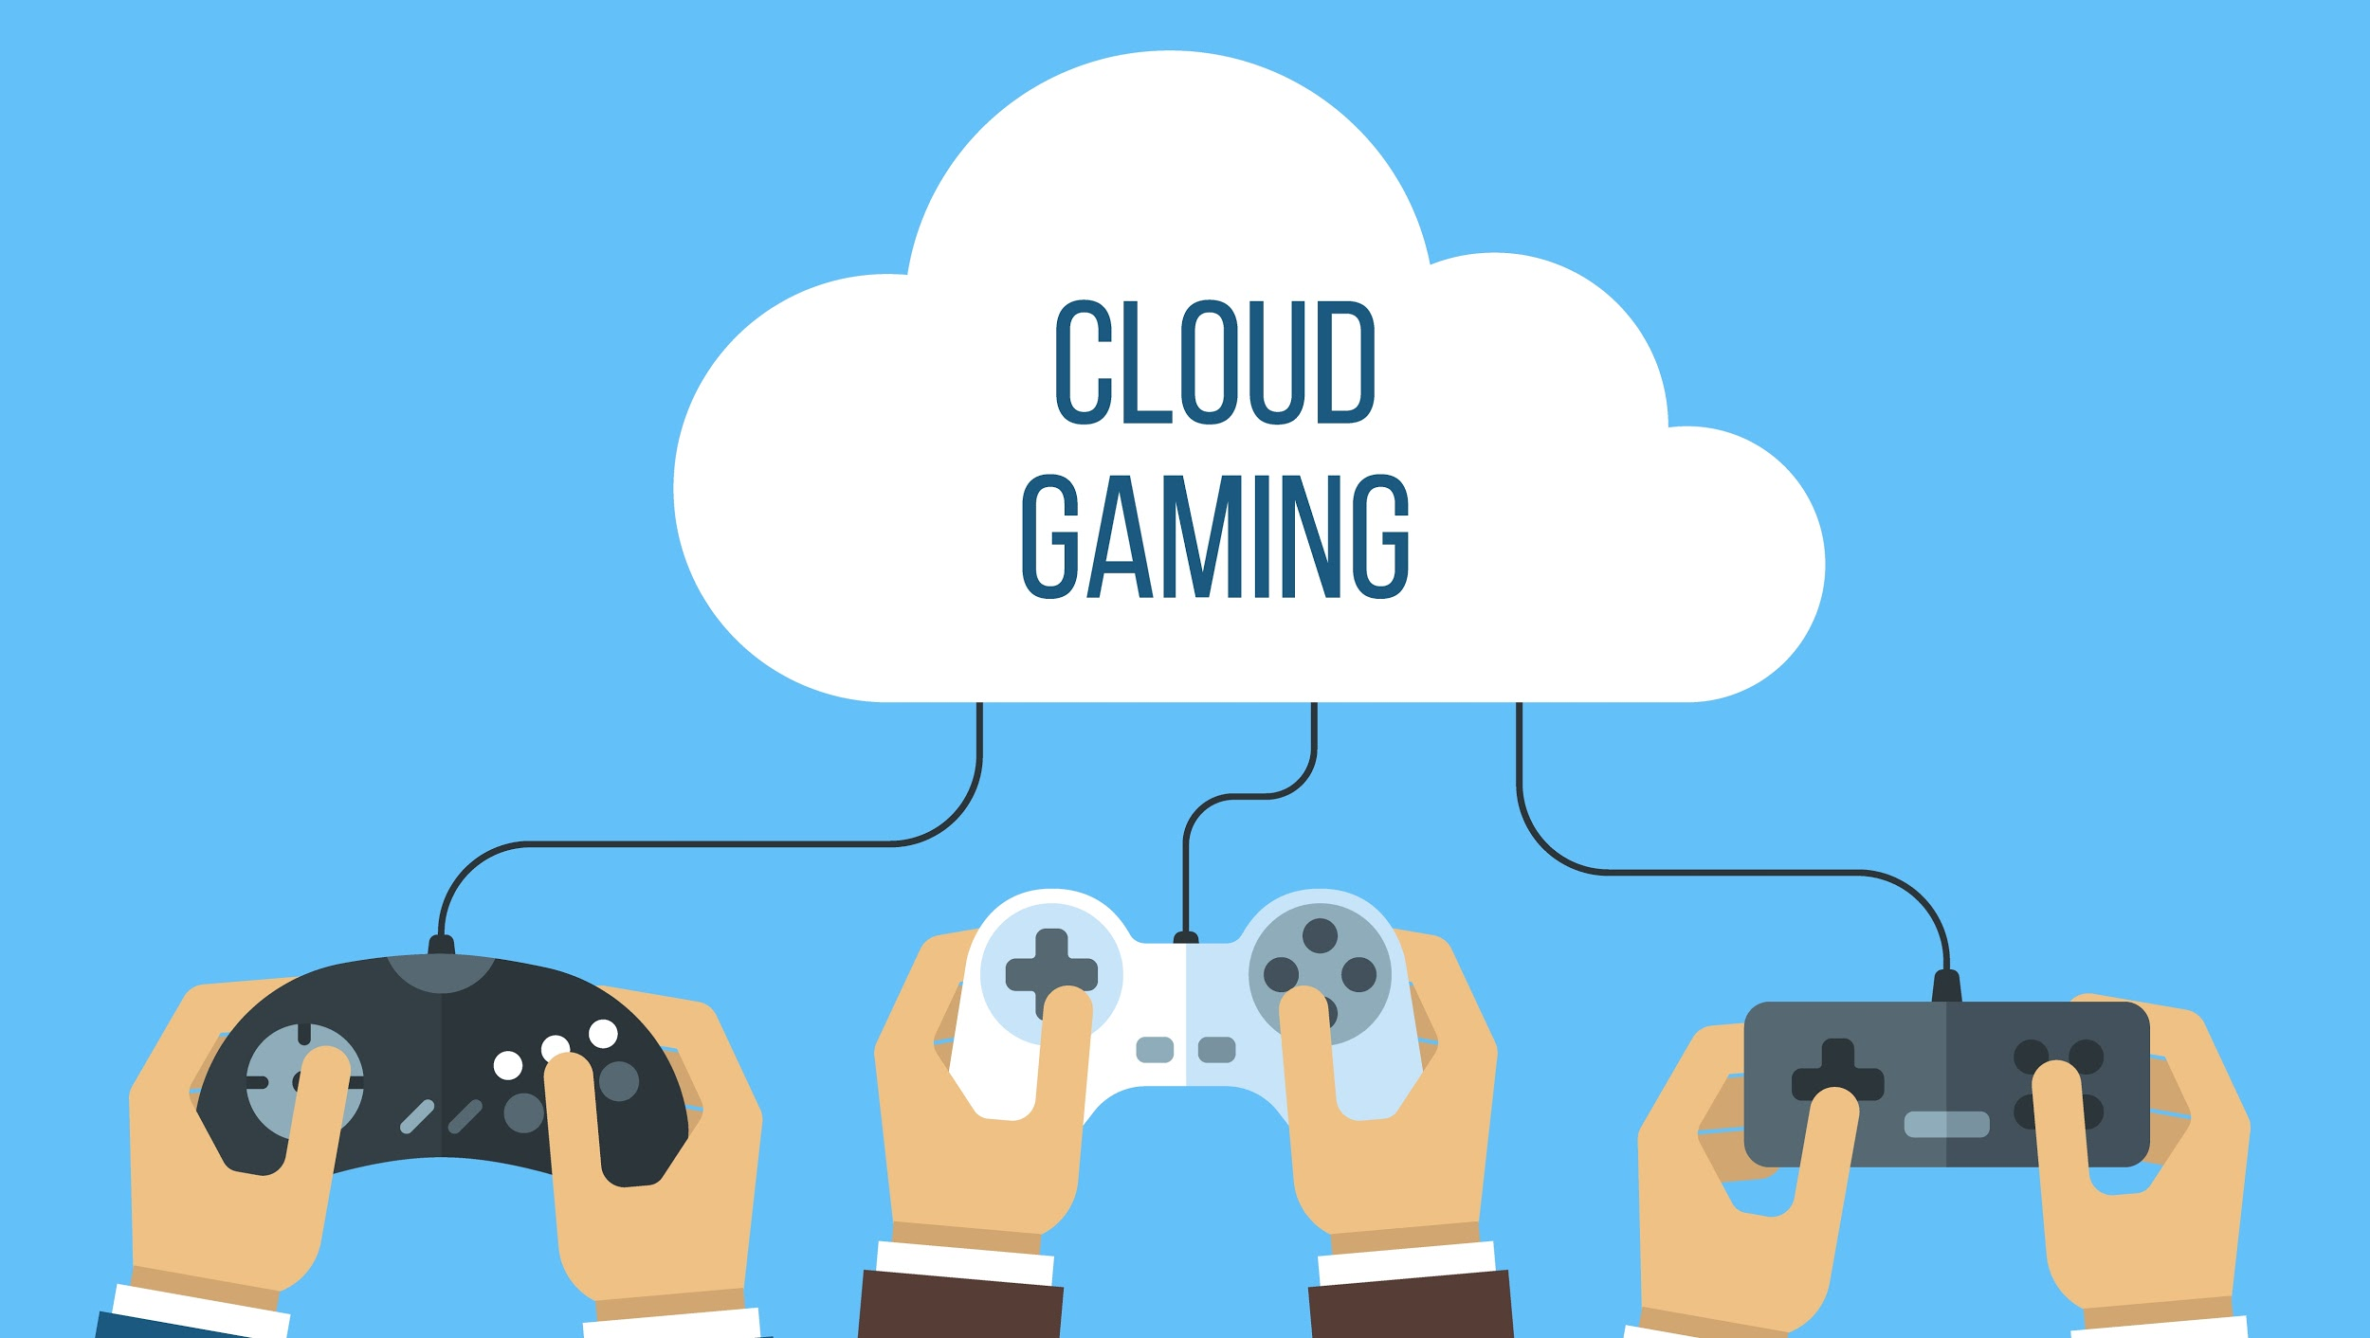
Gaming
What is Cloud Gaming?
Date back to 1970s
Rapid availability of the Internet in the 1990s
Online networking features in 2000s
Notes:
Narbeh

Slide 5
History of Games
Development of games for research and academic purposes
Games played via punch cards
Arcade video gaming
Gaming on home consoles and controllers
Computer Games
Mobile Gaming
Notes:
Narbeh

Slide 6
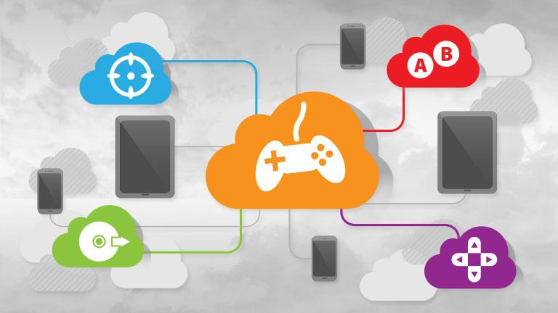
Gaming on the Cloud
Lower cost of technology, servers and the Internet
Web browser as a client
Web-based graphics technologies
Flash and Java
Ajax and WebGL
Notes:
Narbeh

Slide 7
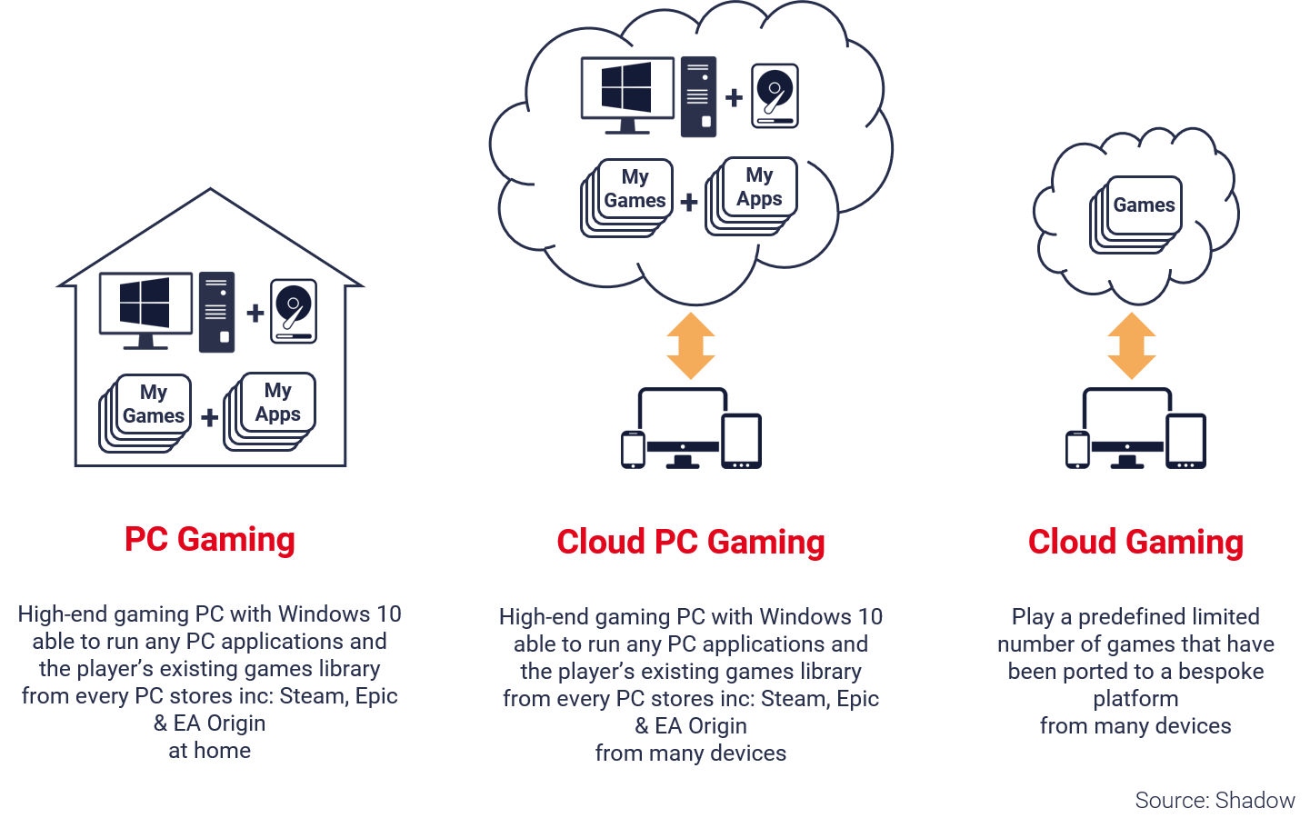
Different types of Gaming Systems

Slide 8
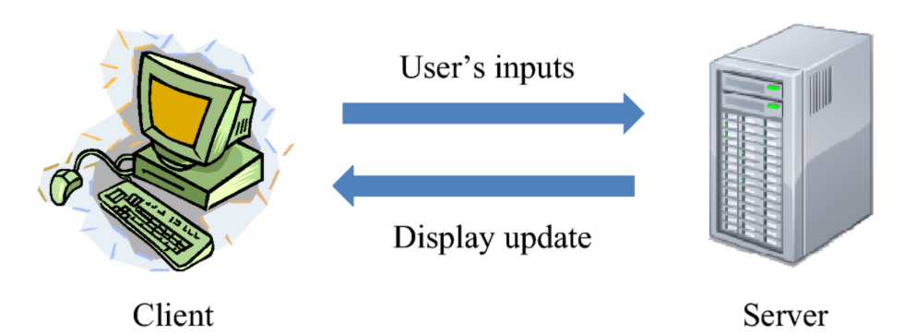
CLOUD GAMING is based on
Thin-client Computing Model

Slide 9
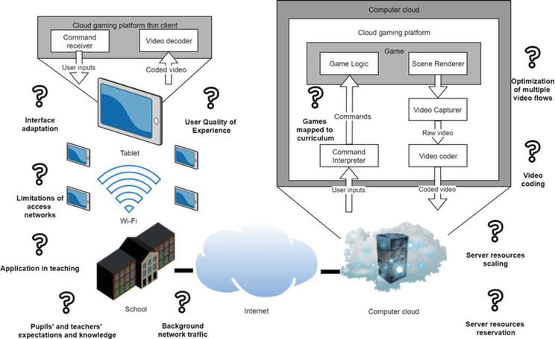
Use Case 1 : Cloud Gaming in Education
Limitations
teachers’ knowledge
Quality educational games
high cost
Notes:
Narbeh

Slide 10
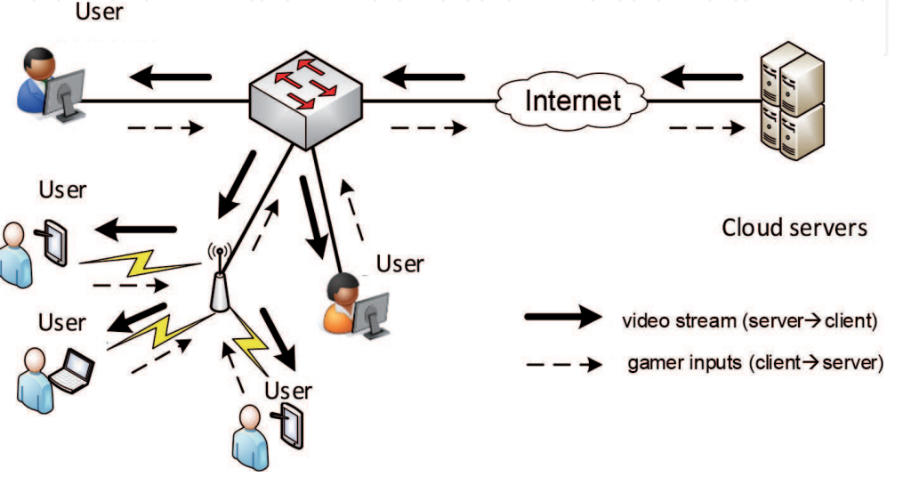
Notes:
Narbeh

Slide 11
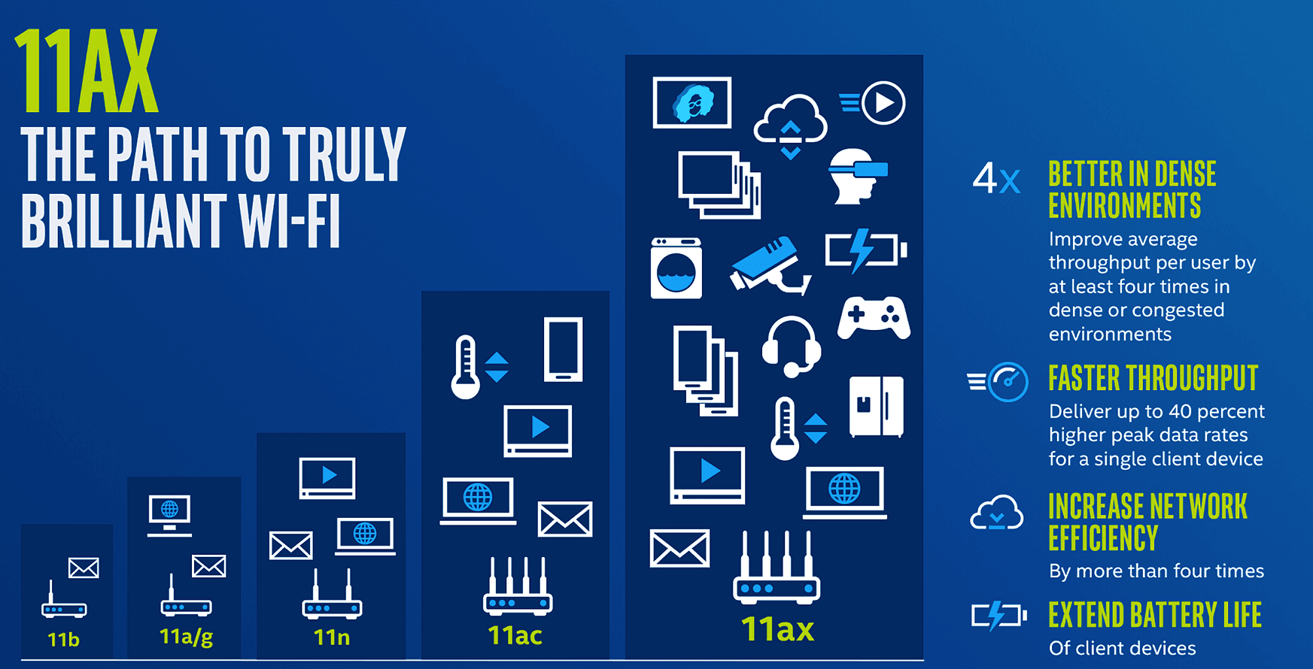
Current Technical Problems
WiFi connectivity as a bottleneck
IEEE 802.11ax
Algorithm Optimization
Video Codecs
Notes:
Narbeh

Slide 12
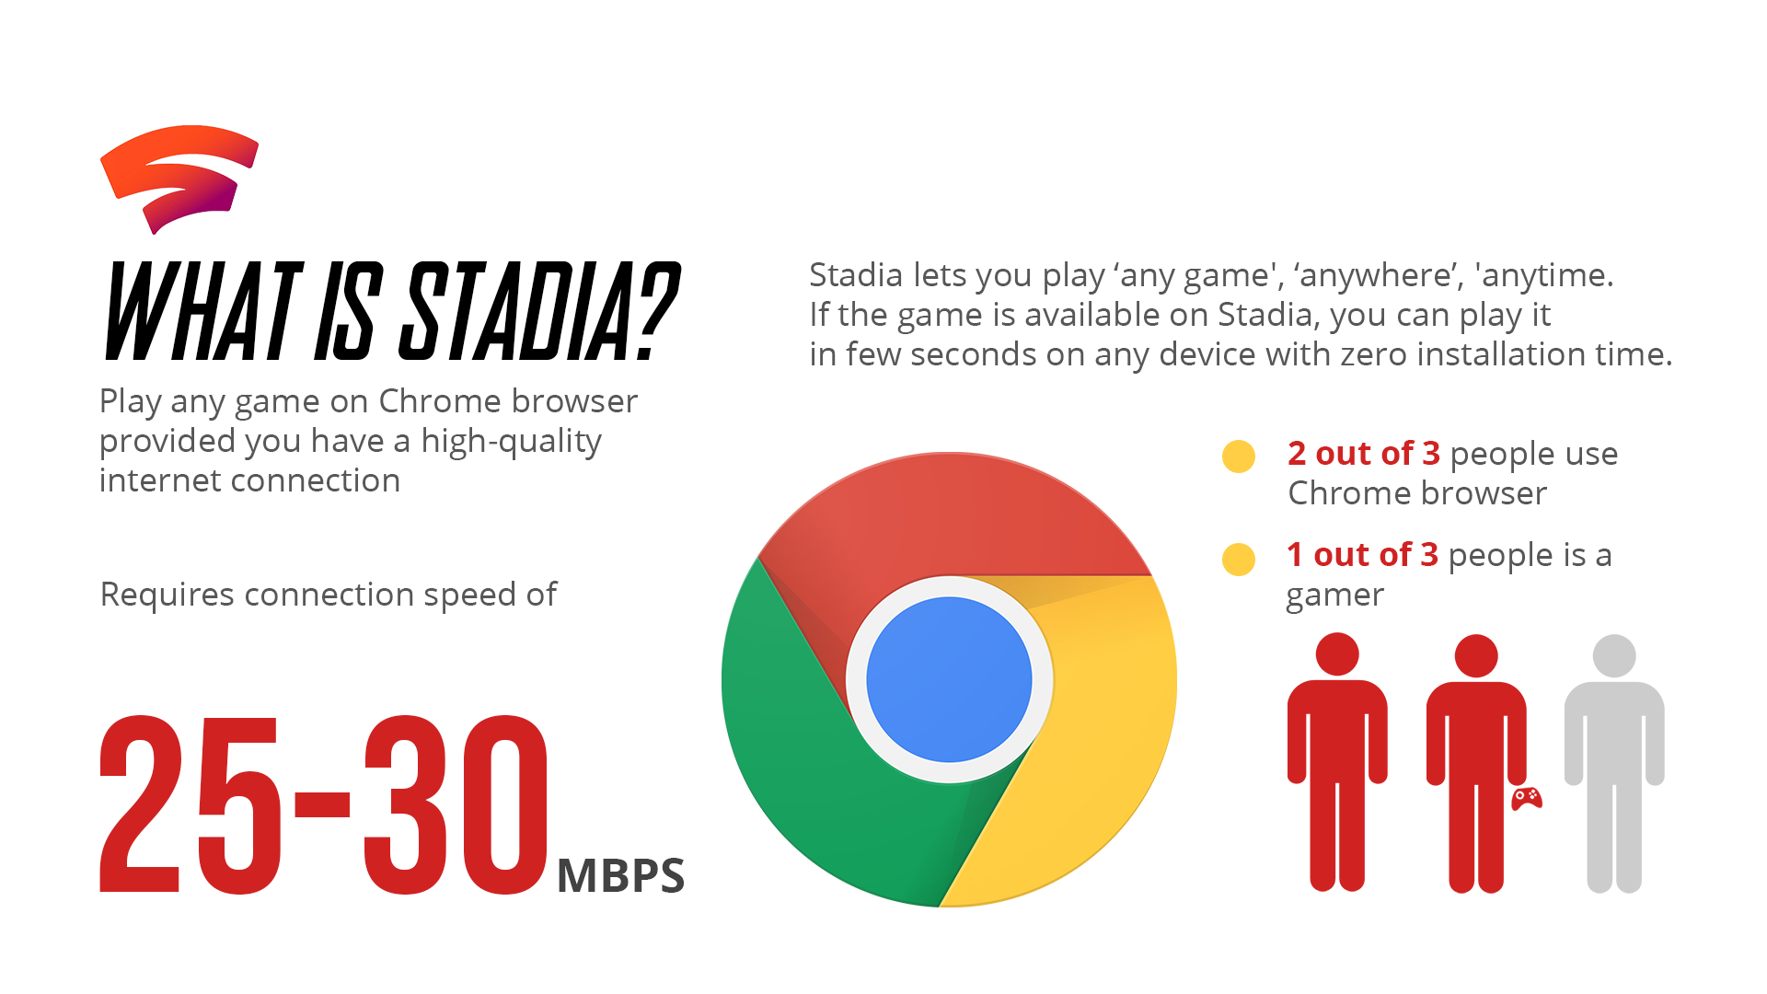
Stadia- Cloud Gaming service by Google
Notes:
Mayur

Slide 13
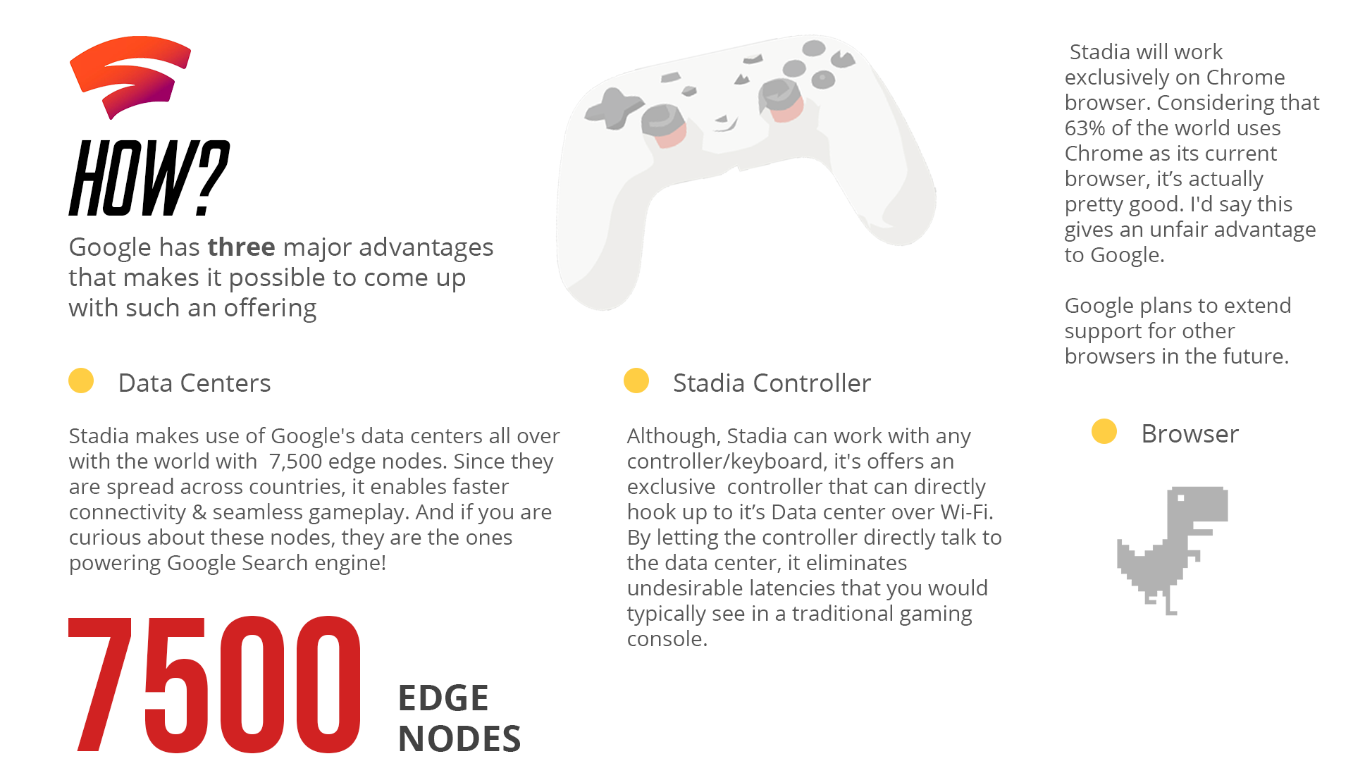
Notes:
Mayur

Slide 14
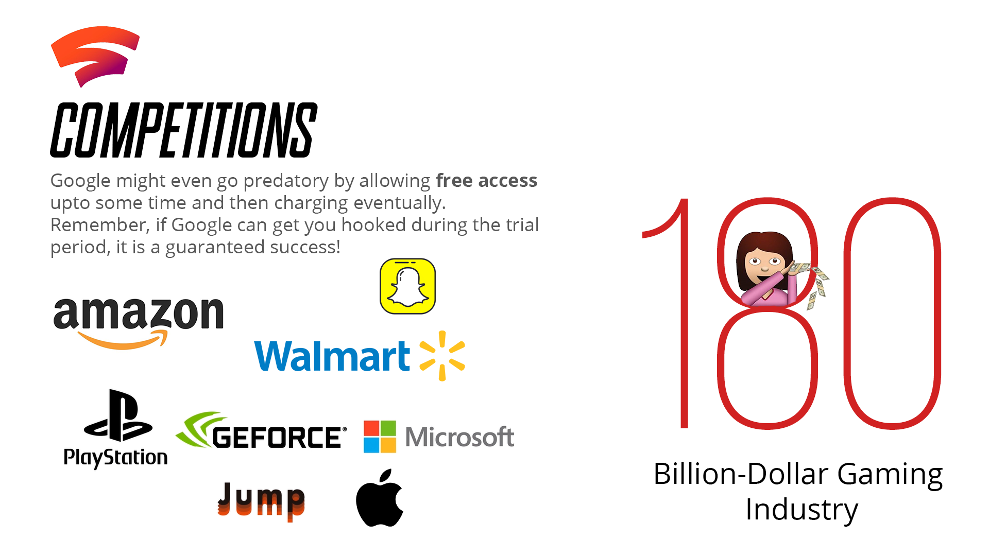
Notes:
Mayur

Slide 15
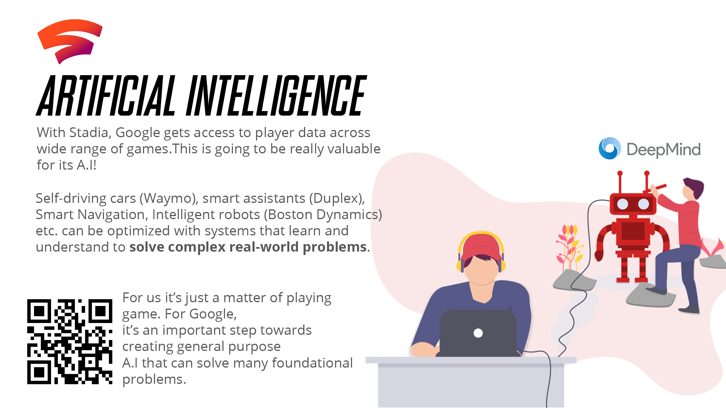
Notes:
Mayur

Slide 16
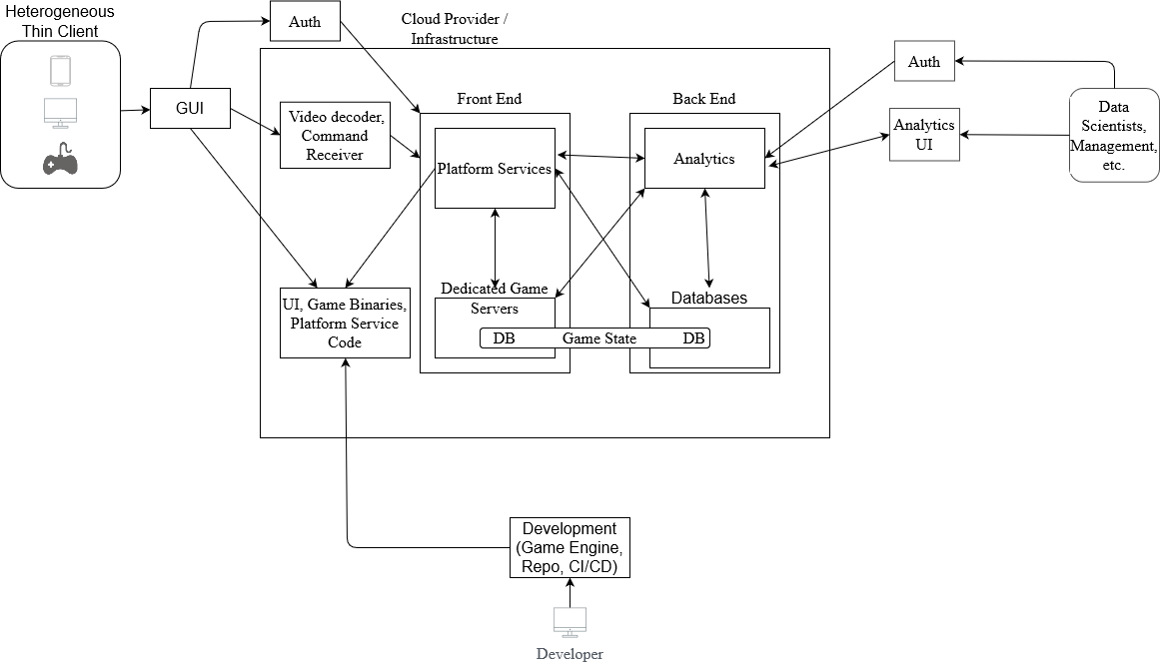
Reference Architecture - The World Map: A Brief View
Notes:
Juan

Slide 17
Development Land
Some of the key points in this area:
Game Engines
Repositories
CI / CD and some modern practices
Releasing the games
Notes:
Juan

Slide 18
Development Land - Creating and Saving
Developers typically need game engines to develop high quality games as they provide a number of benefits:
Ability to interact with the GPU independent of the GPU manufacturer.
Ability to develop for various platforms, allowing for cross-compatibility.
Scripts and assets need to be stored in a repository but may have the issue of being to large for standard Git version control. Software like Git LFS solves this issue.
The code for the various dev teams might include Game Platform Service Code (more on that later) and Infrastructure code (preferably) requiring multiple repositories and pipelines for each.
Notes:
Juan

Slide 19
Development Land - Game Engines / Game Frameworks
There are a number of Game Engines to work with along with IDEs
Amazon Lumberyard
Very new to industry but has the perk of being completely royalty free.
Amazon Lumberyard is a rework and extension of the CryEngine.
Unity Game Engine w/ Visual Studio 20XX
Popular engine offering both 2D and 3D development.
Unreal Game Engine w/ Visual Studio 20XX
The upcoming Rider by Jetbrains can replace Visual Studio.
Crytek CryEngine w/ Visual Studio 20XX
But can it run Crysis…?
Notes:
Juan

Slide 20
Development Land - Building
In the CI/CD pipeline we go through a number of steps:
Testing in a number of ways: Functionality, Combinatorial, Ad Hoc, Compatibility, Clean Room, Tree, Regression, Performance
Packaging versions with different configurations for: QA, Game Stores, Demo purposes.
Send builds to storage (S3, etc.)
Send builds to beta testing software.
Code pushed to the repository should always go through a Continuous Integration / Continuous Delivery pipeline.
This may also have issues with size of the game as games can range anywhere between a couple of megabytes (MB) to tens of gigabytes (GB).
Size of game can cause issues with builds in the pipeline and running the pipeline at every commit is inefficient
A modern approach to builds to break up the build in to containers.
These smaller builds can then be collected by the server running the streaming service as pieces put together on the servicer end, reducing fetching/download times.
When updates occur the user only needs to update certain smaller binaries.
Notes:
Juan

Slide 21
Development Land - Releasing
Typically after testing builds must be pushed somewhere and the server instance needs to access these in some way to stream.
As mentioned previously pushing to storage services such as AWS S3 (sufficient for smaller games) or breaking the binaries into multiple containers to be fetched when the user requests a game.
Notes:
Juan

Slide 22
Users’ Republic
Some of the key points in this area:
Accessing the games as a user.
Authentication for the user’s data.
Notes:
Mayur

Slide 23
Users’ Republic - Accessing a Game
A new method of accessing is via streaming the game similar to Netflix or Hulu Services.
This method requires low latency between the client and the backend services.
Users will also need a larger bandwidth depending on the game played.
First Person Shooters(FPS), Real-time Strategy (RTS), and other multiplayer games will require the user less delay.
Turn based games may require lower bandwidths and can have slightly higher latency
The user accesses owned games via a web client or native application.
To access their games the user must provide credentials.
Once the user has selected their game events will trigger to launch the game on an instance via the front end services.
Notes:
Mayur

Slide 24
Users’ Republic - Authentication
Users need to be authenticated in order to save their data on the cloud, view data from the cloud (account info, games owned, etc.)
Single Sign-On from the client to access user information.
What if the client offers games from different game developers?
SSO can solve that issue as it allows for a single authentication into multiple applications and can be used alongside developer’s APIs to authenticate the user.
What about “in-house” games?
SSO can still be used as games developed under the same company will just verify the user exists in the databases.
Notes:
Mayur

Slide 25
Users’ Republic - Authentication (Cont.)
To add more security using Multi-Factor Authentication (MFA) or Two-Factor Authentication (TFA) when accessing sensitive such as credit card information when buying games or in-game content.
Using online payment systems’ APIs such as PayPal’s APIs can reduce the complications of maintaining user payment information or at least offer another option.
Notes:
Mayur

Slide 26
The Thin Client
Thin Clients are computing devices available at user’s disposal
A thin client usually has
Low-performance hardware
Browser-based Operating System
Diverse I/O system support
High network bandwidth support
Benefits
Cross platform support over different computing devices(Desktops, Smartphones, Smart TVs etc.)
Cost and Energy Efficiency
Design Challenges
Robustness against network impairments such as network delay, packet loss, and small bandwidth
Optimizing for network latency as opposed to bandwidth issues in designing thin-clients
Display frame rate and frame distortion at the client side both being critical to gaming performance
Notes:
Mayur
References
1)On the Performance of Wide-Area Thin-Client Computing ALBERT M. LAI and JASON NIEH Columbia University
2)Understanding The Performance of Thin-Client Gaming Yu-Chun Chang, Po-Han Tseng, Kuan-Ta Chen†, and Chin-Laung Lei,Department of Electrical Engineering, National Taiwan University,Institute of Information Science, Academia Sinica

Slide 27
Front End Empire
Some of the key points in this area:
Game Platform Services so users can access online functionality.
The game servers and the game state.
Notes:
Juan

Slide 28
Front End Empire - Game Platform Services
What are game platform services?
Services provided by various cloud providers to handle in-game and out-of-game functionality.
At this layer load balancing occurs to ensure the user does not run into latency issues or is left in a large waiting queue.
Without auto-scaling from the platform the servers can run into unfavorable issues such as flooding the server with too many requests, potentially breaking the infrastructure.
What are those services?
A number of in game services including but not limited to: chat, matchmaking, leaderboard, authentication, penalization, player profile, and analytics (more on analytics later).
Notes:
Juan

Slide 29
Front End Empire - Game Platform Services (Cont.)
How does the platform service code work?
Developers / Infrastructure team needs to create scripts based on the services used such as scaling.
The service is run in a serverless function, connecting the user to the appropriate platform service and/ or server.
The client requests one of the services provided by cloud providers and set up by the developers.
The service will then connect the user with the requested information, whether it be in game information or link to a server instance in the case of matchmaking.
Notes:
Juan

Slide 30
Front End Empire - Game Platform Services (Cont.)
Why not create the platform services if we’re already making the games?
Many modern games are catered for the multiplayer experience gameplay and require scaling when more and more users attempt to access a server/ match instance.
Good examples of multiplayer games with many players per match:
Warframe (up to 3 players per match)
Super Smash Bros. Ultimate (up to 4 players per match)
League of Legends (up to 10 players per match)
Overwatch (up to 12 players per match)
Apex Legends (up to 60 players per match)
Sea of Thieves (up to 99 players per server)
Minecraft (up to 2³¹ players per server in theory)
Both Java and Bedrock Editions
Notes:
Juan

Slide 31
Front End Empire - Game Platform Services (Cont.)
Why not create the platform services if we’re already making the games?
The games mentioned tend to have thousands of players to millions of players live at any point in time.
All these require multiple instances of the server and housing all instances of the game at once can create high latency and cause dissatisfaction on the user end.
Cloud providers offering game platform services auto-scale horizontally to avoid the worry that too many server instances exist on a single computer.
Not to mention this can be extremely costly due to hardware when scaling “in-house.”
We also don’t want to have to build all of the hardware to host all of the streaming. It’s an expense that will be high, much greater than paying for a GPU service to stream.
Notes:
Juan

Slide 32
Front End Empire - Game Platform Services (Cont.)
These games serve multiple regions across the globe. How do platform services help?
Multiple regions depends on the cloud provider.
In the case of AWS GameLift, Google Cloud Gaming, and Heroic Labs Nakama allow for multiple regions across the world.
The regions can be customized to cater to specific regions with a set number of players playing per server.
Databases are also made region specific per instance (more on that later).
Notes:
Juan

Slide 33
Front End Empire - The Servers and the Game State
Using platform services server instances can be created with the services providing a way to keep the game state stored and updated in a database.
The created server will communicate with a database to keep the state as up to date as possible.
Servers in the front end?
In a sense, yes. The thin client needs to interact directly with the servers based on user commands.
The user does not directly interact with the servers but through the proxy thin client. Hiding the server instances further leads to high latency.
Notes:
Juan

Slide 34
The Game State Diplomacy
What is the game state?
Video games can be considered large state machines and game state a token at a certain point in the state machine.
When users interact with one another or with the environment the state changes and must be updated for all users in the server instance.
Transferring the game state between users causes plenty of issues.
Latency when transferring the game state between users is further increased especially with cloud gaming due to the middleman thin client.
Solutions
Predict other client interaction before it is received.
Waiting for all clients to receive the new state.
Terribly slow and can cause latency.
Notes:
Mayur

Slide 35
Back End Alliance
Some of the key points in this area:
Databases and the game state.
Using databases for other purposes in games.
Game Analytics (Game Telemetry)
A focus on how analytics changes the state of the game and services used.
Notes:
Mayur

Slide 36
Back End Alliance - Databases and the Game State
In order to make sure we can distribute the game state to all users we need to somehow save it to a database.
But why a database?
For the most part it works like a cache system where we can quickly store and distribute.
The database also helps when the game session crashes. Once the game session is returned we can distribute the last known state to all the clients.
Another benefit is that many cloud providers simplify the creation of a backup for in case something goes wrong.
Cache system? Just use that.
There are plenty of updates and it might work but we also might want to store information about the game for analytics purposes.
If the ship goes down, so does the captain. If an issue occurs in caching system the game state and other data will be lost.
Notes:
Mayur

Slide 37
Back End Alliance - Databases for Other Purposes
As mentioned before we might want to want to analyze the current state of the game from a bigger picture.
In-game changes and internal infrastructure changes may happen as a game increases in size.
User information such as games owned, time played, or any other purchases should be kept for both user purposes and analytics purposes.
Backups, backups, backups.
Backups to data should always be considered.
Distribute these geographically and on a regular bases.
Archiving when?
It might be good to archive game data on a daily basis if the game garners a large audience due to the sheer amount of data produced.
User data might be better to hold off.
Notes:
Juan

Slide 38
Back End Alliance - Analytics and Changes
In terms of analytics there are many areas to observe.
Monitoring and analysis of servers, devices, user behavior.
Even user behavior can be broken up into more sections such as purchasing behavior interaction with other users, interaction with services in the application.
A lot of these areas will change the state of the game and even the infrastructure.
But what do we save and look at?
Really just a bunch of raw data to be parsed down from the database.
A good example is looking at how players behave in certain areas of maps in games.
Notes:
Juan

Slide 39
Back End Alliance - Analytics and Changes (Cont.)
Before analyzing any data we can create variables based on the player such as ID, session lengths, characters used, areas explored, etc.
This data is a “snapshot” in time of the game state.
After parsing the data we can display it via a UI for any number of internal employees (data scientist, management, even game designers).
Any number of data analytics services from data visualization platforms such as Tableau.
The data can lead to removal of services such as in-game group chat.
Case of this was in 2020 when Riot Games, creators of League of Legends and Valorant, removed the “clan” service where users could create groups to discuss. A number of reasons such as misuse of the service, private selling of “tags,” and expense prompted analysts to push for the removal.
Notes:
Juan

Slide 40
Back End Alliance - Analytics and Changes (Cont.)
More on analytics in Game Analytics: Maximizing the Value of Player Data published by Springer London.
Although an older book it paves the way to modern game analytics and is a good read to understand the importance of game analytics.
Notes:
Juan

Slide 41
Back End Alliance - Analytics and Changes (Cont.)
Like in any other application you will want a number of tools to simplify the data analytics.
Asynchronous messaging systems like a Pub/Sub system to be able to collect data during any game session.
Data processing tools to view the data passed by the messaging system.
The data will be parsed and sent to any number of analytics engines.
Analytics engines allows us to have processed data in a simple to view way.
All of the data can then be viewed through a data visualization tool.
Notes:
Juan

Slide 42
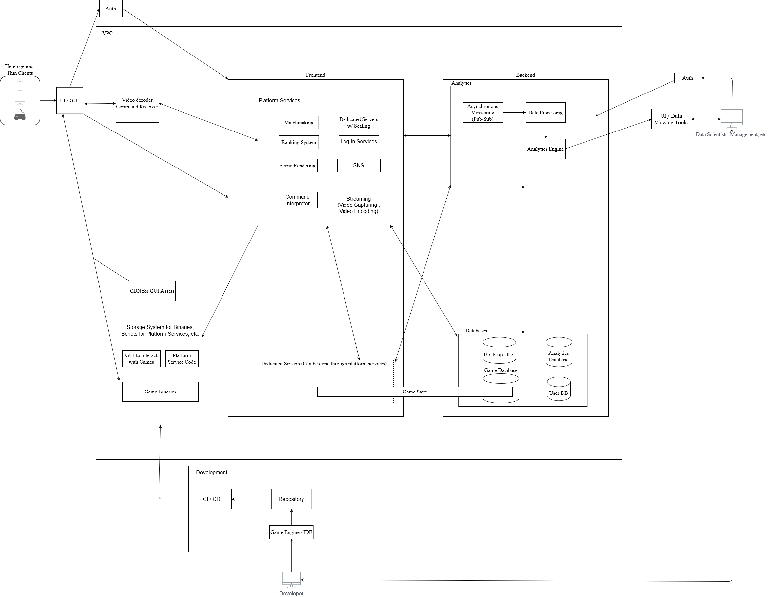
Reference Architecture: The Complete World Map
Notes:
Juan

Slide 43
Some Key Issues You’re Probably Wondering
What about multiple users when they access the website / application that streams?
Typically you would want a load balancer between the client and the services so the user has a little latency as possible in any part of the application.
What manages the infrastructure anyways?
That can be upto the architect. We recommend the Infrastructure as Code (IaC) approach as it promotes a healthy infrastructure without needing to manually set scripts and configurations.
What about setting up those servers for rendering?
This is the tough part and requires the creation of a service to stream.
At the time of this research Google Stadia and Nvidia GeForce Now are two of the dominating providers that can be used for cloud gaming.
Amazon Luna is an upcoming service but is currently in early access.
Another option is to rent GPUs that communicate with both the platform services and the client.
Notes:
purva

Slide 44
Some Key Issues You’re Probably Wondering (Cont.)
So, about setting up analytics?
In this seminar we didn’t not go into depth on how to set up an analytics section on the backend. For the majority of the section there are areas that are similar to any other application’s analytics.
Potentially the Pub/Sub model can be substituted if desired.
So what’s the CDN for in the reference architecture?
Naturally if we have a web page we probably want to cache static assets somewhere where all users can access quickly.
What happens if the system has too many people from around the world?
Typically we want to create regions around different parts of the world. That’s why when you play games you hear NA servers that you access when you’re in North America.
Notes:
purva

Slide 45
Questions

